Slide 1


DETECTOR
Heroic SHARKS
Helwan University , Cairo - Egypt
28 August 2023
T H E B E S T P R O T E C T I O N I S T H E E A R L Y D E T E C T I O N

Slide 2


Slide 3




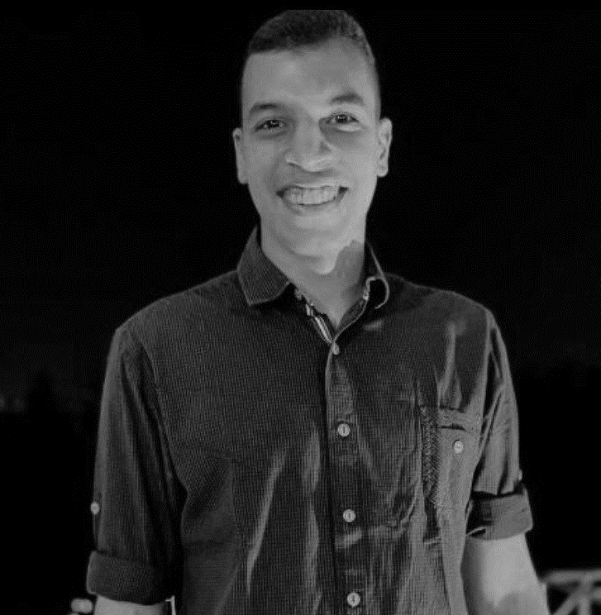

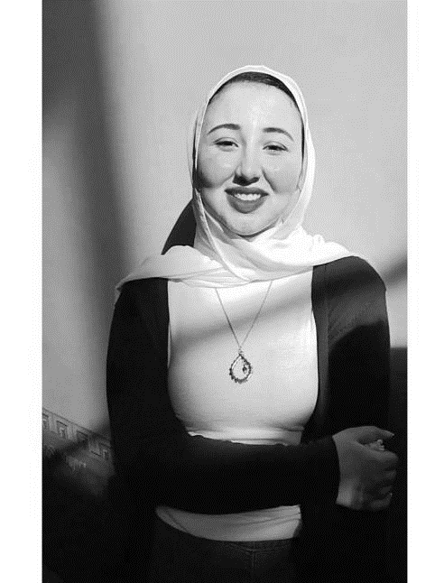
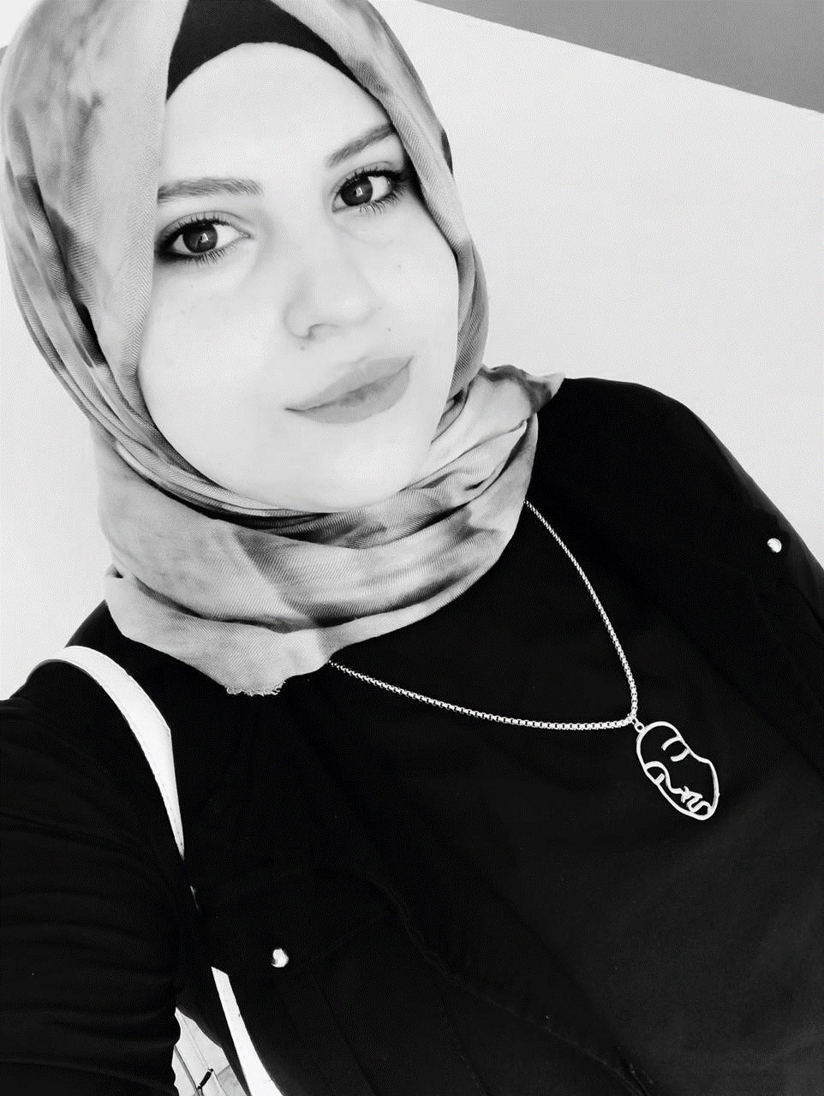
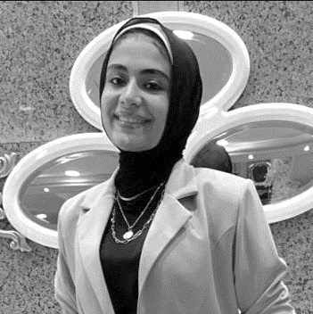
Founders
Ahmed Elbehairy Designer
Mohamed Helal Leader
Shady Mohamed Web Developer
Esraa Mahmoud Content Creator
Nourhan El-Far Marketing officer
Nervan Hossam Content Creator
Notes:
Put your team photos or group photo.
Write your names and emails.

Slide 4


Addressing the Issue of Disorientation Faced by Every Student at the Faculty of Commerce, after a period of entering college, due to the collision between academic education and practical application in the job market.
The student finds themselves at a crossroads: Should they continue committing to attending lectures and studying to maintain their GPA, or should they immerse themselves in the whirlpool of self-development.
The
Problem

Slide 5
Personas
Asmaa - 22 years old - Student of Fourth Division | Yousef - 21 years old - Student of Third Division
Requirements: Practical Application & Technological Skills Development Acquiring practical skills and experience | Requirements: Awareness-raising in different areas A direct and integrated plan to reach the goal
Challenges: Collision with working life Wasting time without interest | Challenges: Technological Development Loss of passion and constant frustration scattering between different fields
Available alternatives: External courses and lectures, raising the cost Research, self-learning and therefore more time waste | Available alternatives: Take experienced consultations that are difficult to reach

Slide 6
Empathy Field work
We’re providing our Solution for Commerce Students
We’ve Engaged in face-to-face communication with students and conducting surveys to gather their opinions.- Observing students' questions and discussions on social media platforms regarding career fields and the necessary skills.

Slide 7
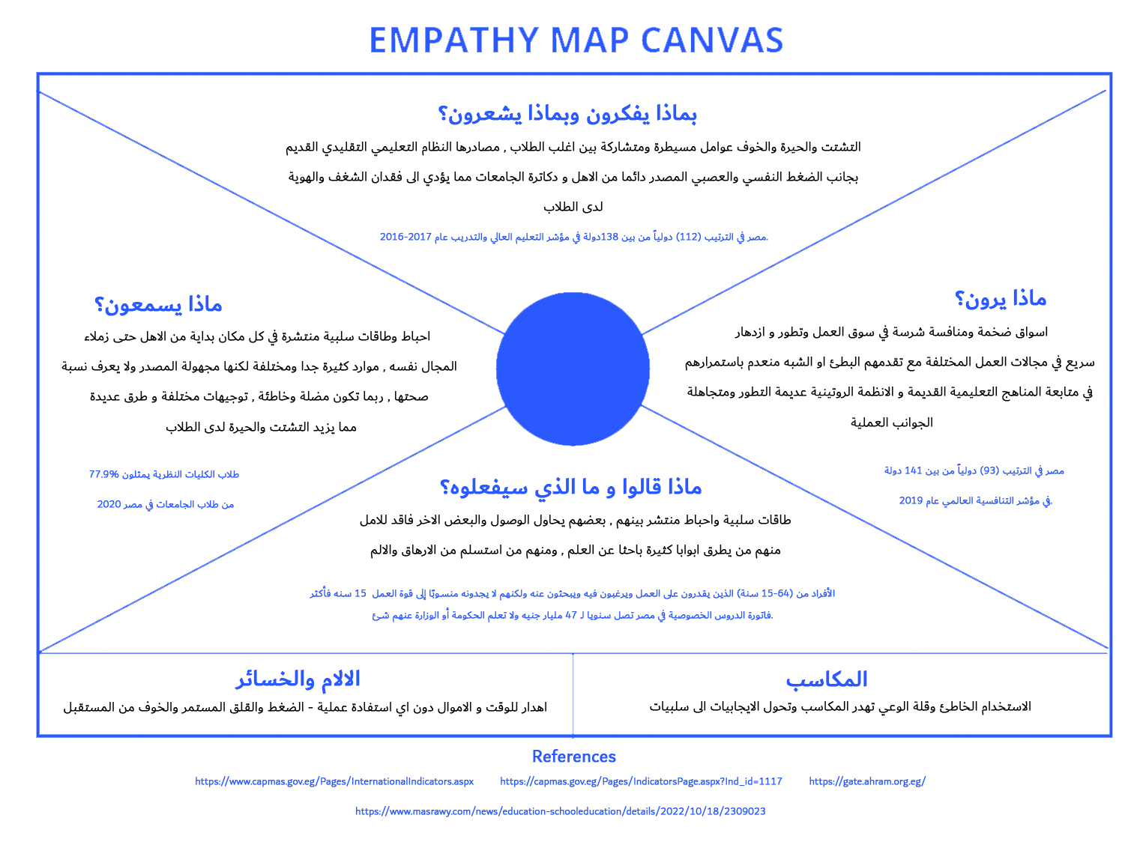

Slide 8
Problem Definition
The dispersion that each university student faces, starting from entering the university and how to choose the right field until graduation and job search.

Slide 9
How Might We …?
Help students assess their skills and discover their abilities.
Assist in choosing the appropriate career path.
Enable practical application.
Facilitate the acquisition of new experiences and skills.
Aid in time management, effort, and cost savings.

Slide 10
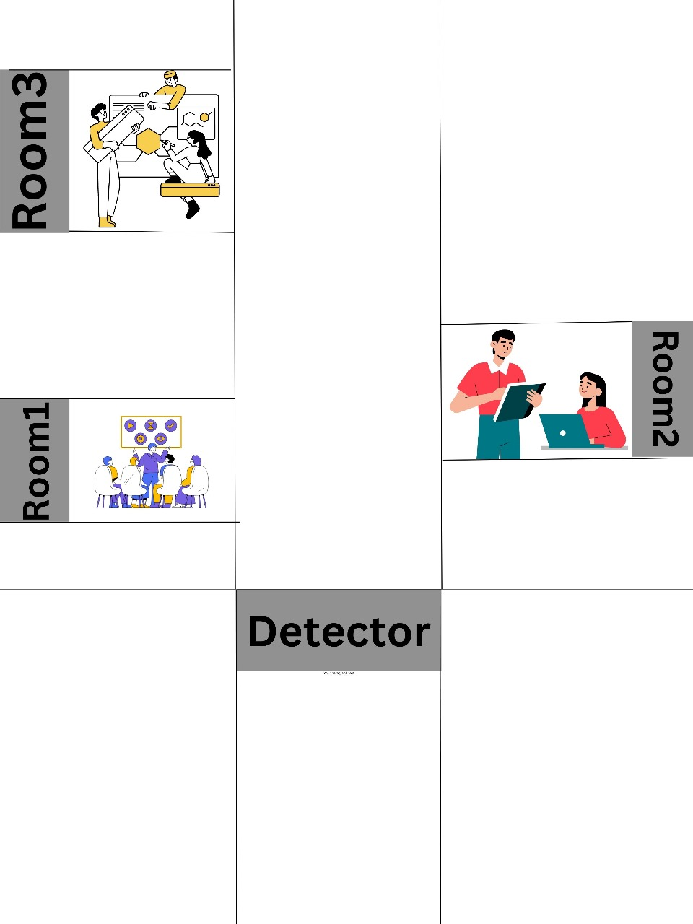
Selected Idea
A physical place close to the students, and a website that completes our idea by using artificial intelligence technology and machine learning

Slide 11
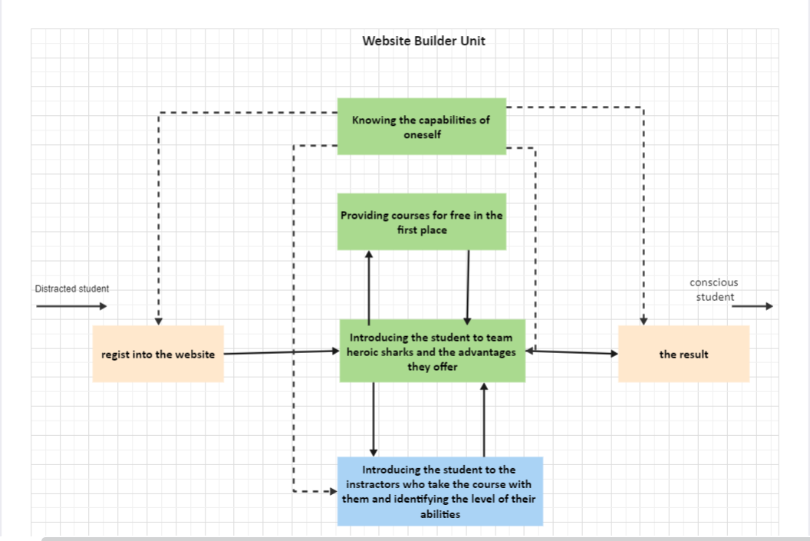
Technology Description
What are the tech components of the product? Explain.
We used different technologies such as HTML, CSS and javascript to create a professional website that is able to benefit the student, dispersing the uselessness to someone who is able to show himself in the community.

Slide 12
Prototype
we've developed for addressing the challenges faced by students at the Faculty of Commerce. Our prototype is designed to provide a practical solution that bridges the gap between academic learning and real-world application. This prototype aims to help students better prepare themselves for the job market while maintaining their academic performance.

Slide 13
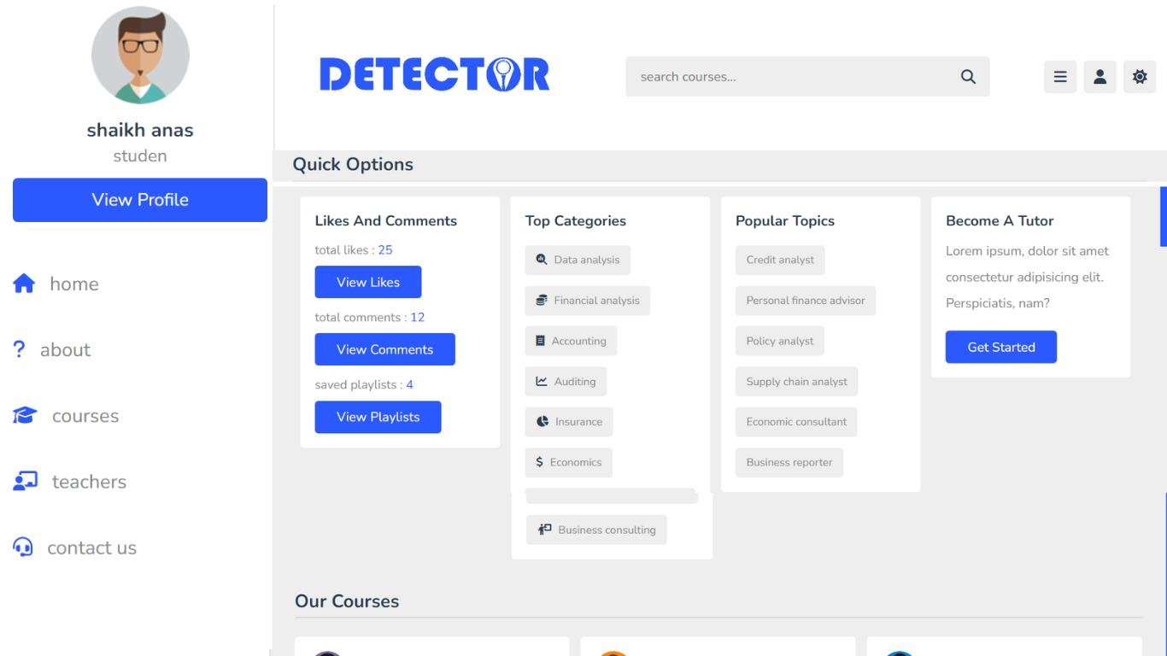
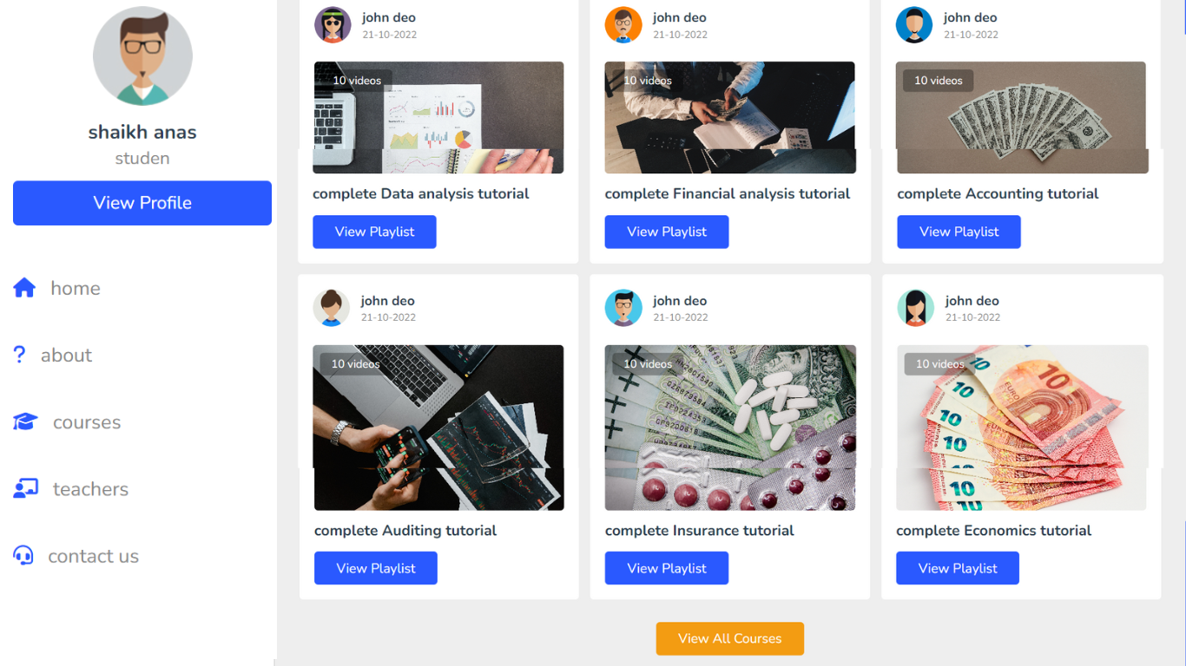
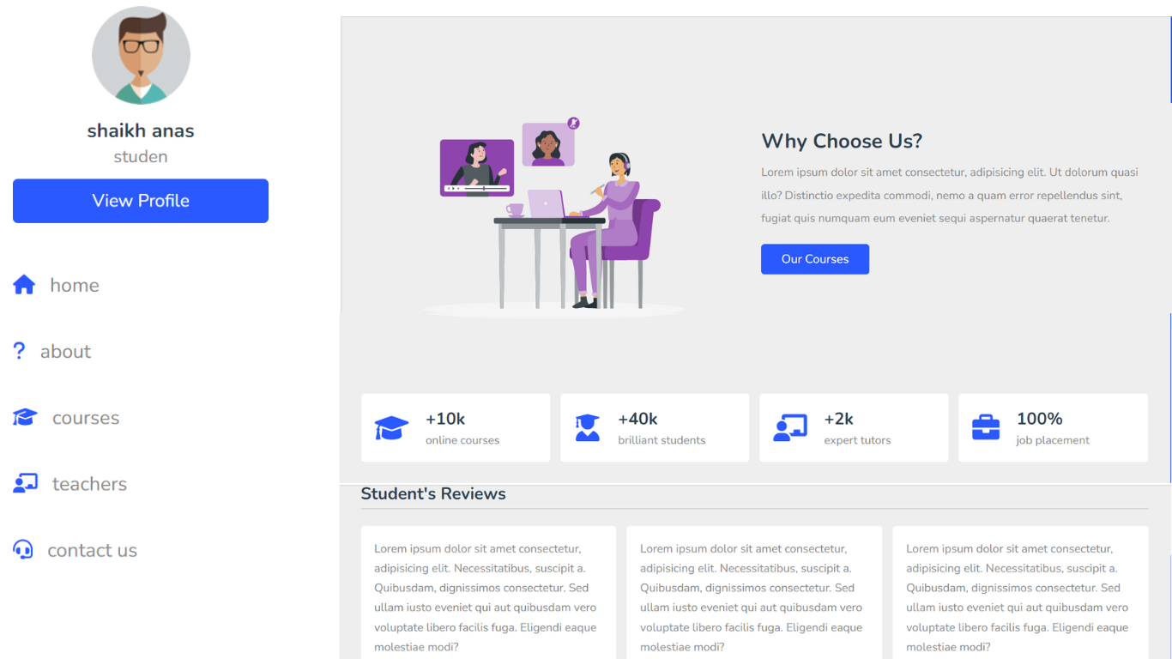
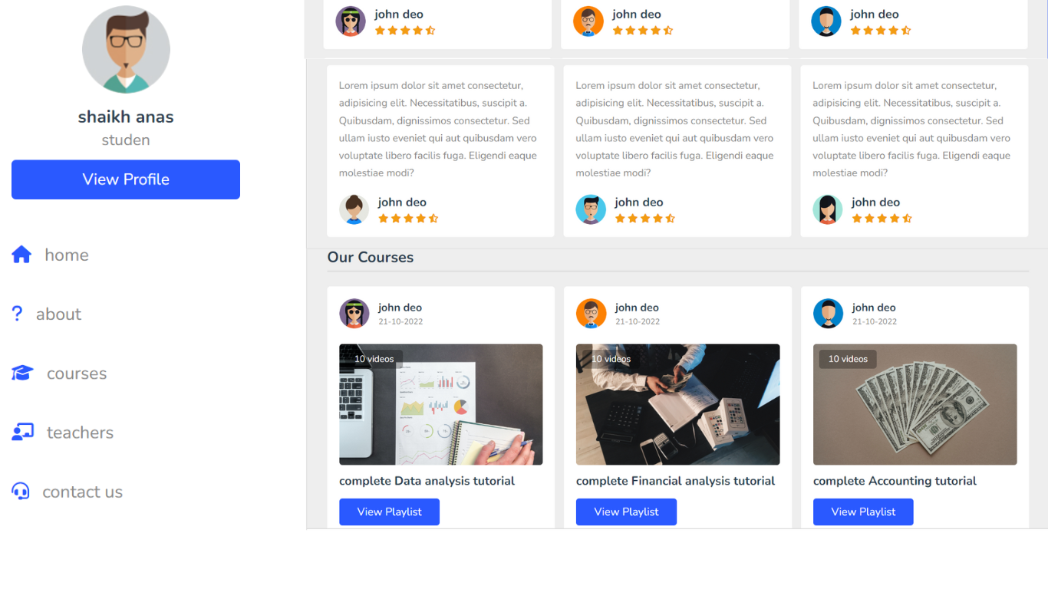
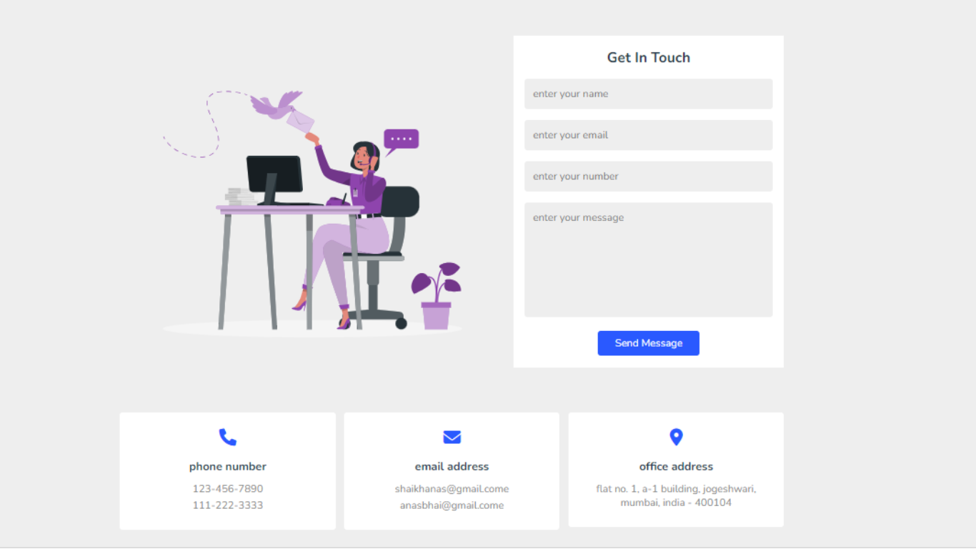
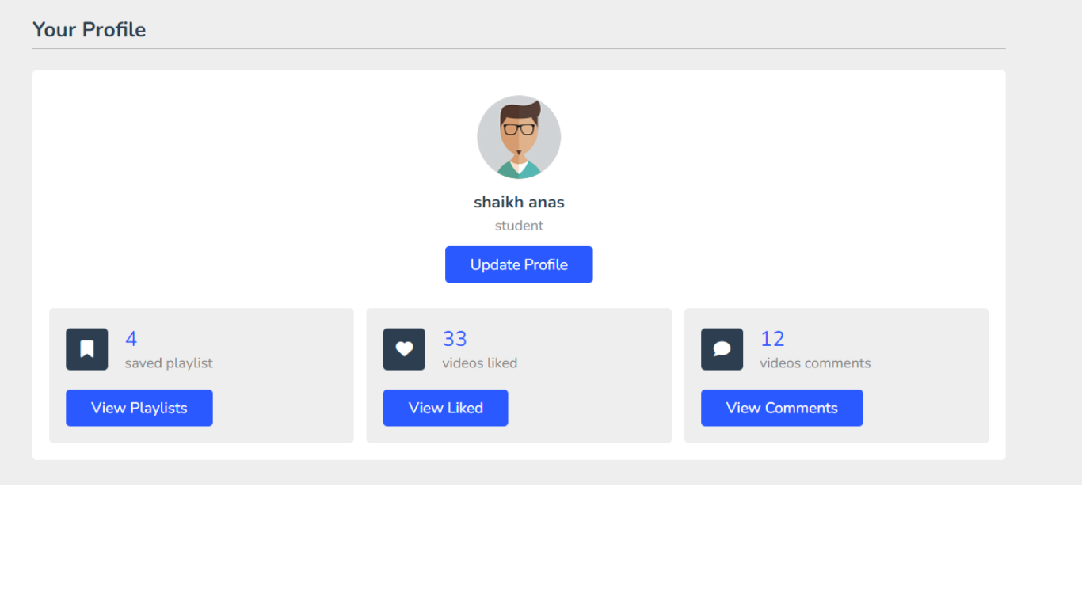
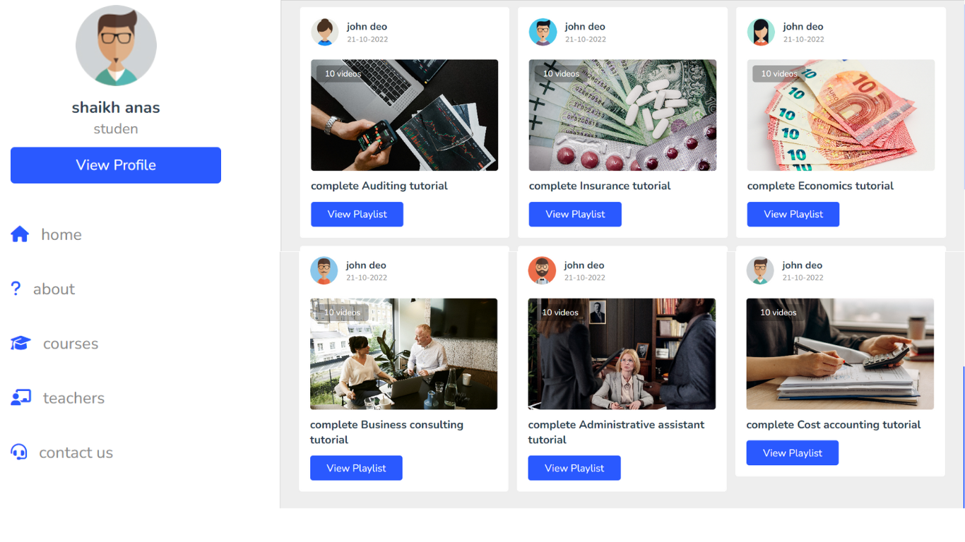
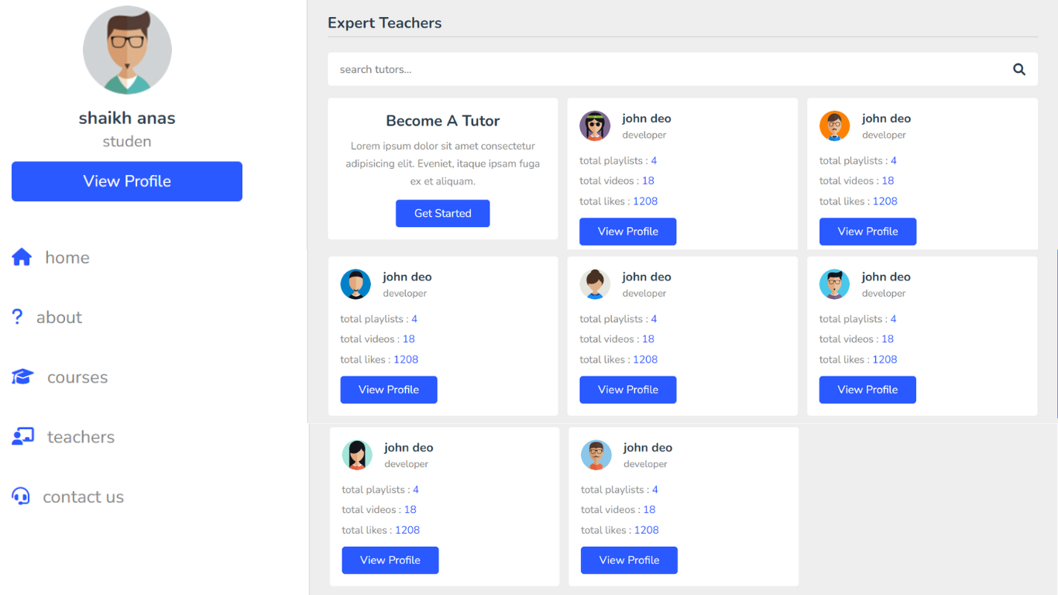
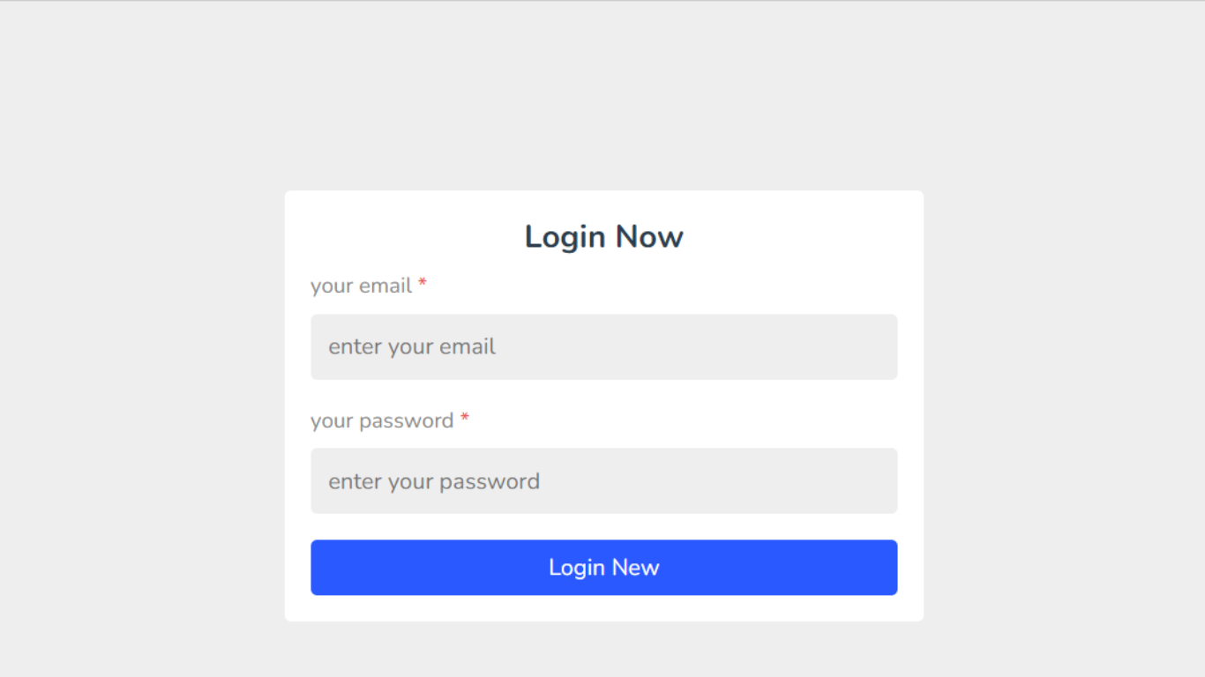
Prototype Photos

Slide 14
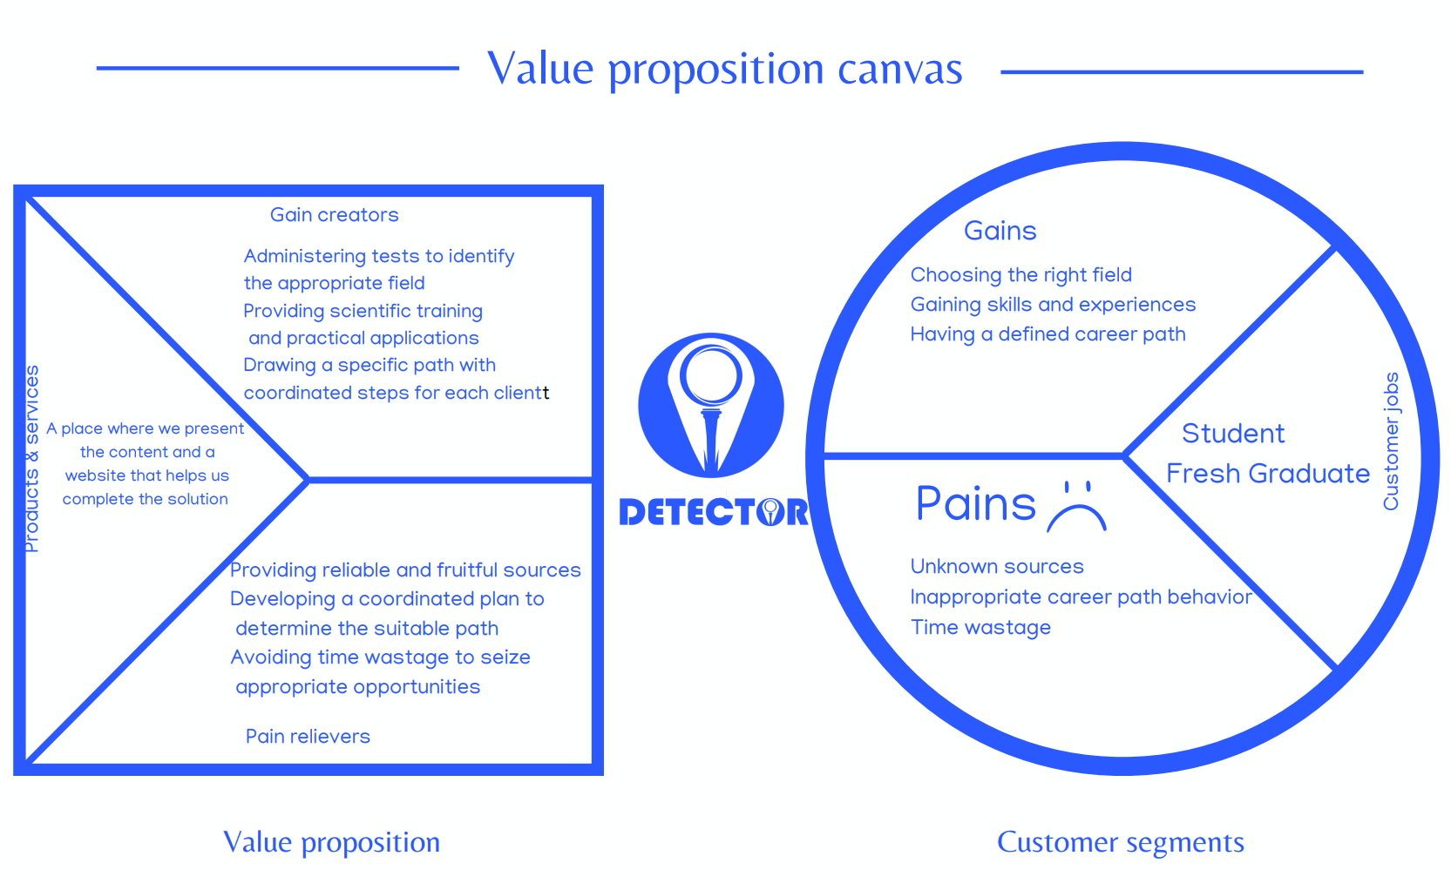

Slide 15

Key Partners
The project has 3 main partners:
Key Activities
The main key activity is:
Value Proposition
Your Body text
Customer Relationship
The main points:
Customer Segments
The specific target is:
Projects Challenges
Professional Instructors
Educate students and understand their abilities to guide them to the right career
Recognize individuals' abilities
Provide reliable sources of learning
Practical practice and experience of the required areas
Coordinated plans to reach the target
Work to develop the student's mentality to qualify him for the labour market
Ads on Social Media
Free university lectures to introduce ourselves to students
Business Model Canvas
College of Commerce Students
Public Universities
Key Resources
Main keys:
Channels
Professional Instructors
Lecture processing equipment
Teaching Materials
Marketing & Customer Service
Development & Design
Sponsor's
Website and rooms for training and lectures on the ground
27-August 2023
Cost Structure
Main costs:
Revenue Streams
Marketing
Rentals
Salaries
Cost of educational materials and sources
Fees for educational materials and sources
Advertising for others
Subscription fees
Notes:
Summarizing all information in previous slides the in one Canvas

Slide 16


Thank You
Notes:
Flow

